Slide 1
Bloom Filter on Trees
Vedanshi Shah

Slide 2
Introduction
Searching in N-ary trees.
If a node is to be searched, either we can give T/F or the entire path followed to reach it. Two naïve approaches: BFS, DFS
Worst case time taken O(n).
Modified approach:
Go to only those paths that have the probability of containing the element.
Using some kinds of filters: Bloom filter, Cuckoo filter, Vacuum filter
At every node decide which paths to tread.
Worst case time taken O(h).

Slide 3



Bloom Filter
A Bloom filter is a space-efficient probabilistic data structure that is used to test whether an element is a member of a set.
Uses hash functions to set a bit in a bit vector.
p = probability of false positive
k = no. of hash functions
n = size of input set
m = size of bloom filter in bits

Slide 4
Hash Functions used
The hash function used in bloom filters should be independent and uniformly distributed.
Fast simple non cryptographic hashes include:
Murmur
FNV
Jenkins Hash
Djb2
sdbm

Slide 5

Cuckoo Filter
Similar to bloom filters, but supports deletion.
Cuckoo Filters operate by hashing an entry with one hash function, and inserting a small f-bit fingerprint of the entry into an open position in either of two alternate buckets. When both buckets are full, the filter recursively kicks existing entries to their alternate buckets until space is found or attempts are exhausted. Lookups repeat the hash function and check both buckets for the fingerprint. When a matching fingerprint is not found, the entry is definitely not in the filter. When a matching fingerprint is found in either bucket, the entry might be in the filter. False positives occur when another entry inserted a mathcing fingerprint into either of the two checked buckets. Deletion is supported by removing one instance of an entry's fingerprint from either bucket.

Slide 6
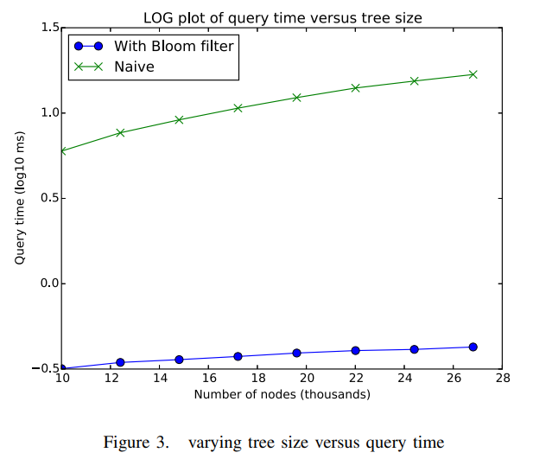
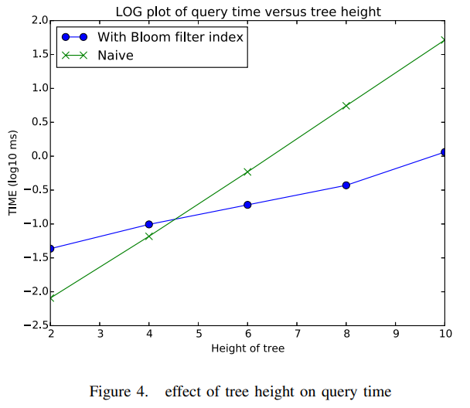
Analysis

